Slide 1


Unit 1
Performance Tuning
Prof. Ketan J PAtel

Slide 2
Introduction
I am running the Acme project.
My requirement is to allow 1000 concurrent users to access the application.
But when I try to access the application with 250 users, the server slows down and finally throws an exception "Could not establish a connection with the database.
Does anyone have an idea please help me to solve my problem."

Slide 3
Introduction
In the beginning, performance was not a concern for software. Early programming languages like C or Cobol were doing a decent job of developing applications and the end user was just discovering the wonders of information technology that would allow him to save a lot of time.
Today we are all aware of the rapidly changing business environment in which we work and live and the impact it has on business and information technology. We recognize that an organization needs to deliver faster services to a larger set of people and companies, and that downtime or poor responses of those services will have a significant impact on the business.

Slide 4
Introduction
To survive and thrive in such an environment, organizations must consider it an imperative task for their businesses to deliver applications faster than their competitors or they will risk losing potential revenue and reputation among customers.
So tuning an application in today’s market is firstly a necessity for survival, but, there are even more subtle reasons, like using your system resources more efficiently. For example, if you manage to meet your system requirements with fewer fixed costs (let’s say by using eight CPU machine instead of a 16 one) you are actually using your resources more efficiently and thus saving money. As an additional benefit you can also reduce some variable costs like the price of software licenses, which are usually calculated on the amount of CPUs used.

Slide 5
What is Performance?
The term "performance" commonly refers to how quickly an application can be executed. In terms of the user’s perspective on performance, the definition is quite easy to grasp.
For example, a fast website means one that is able to load web pages very quickly.
From an administrator’s point of view, the concept needs to be translated into meaningful numbers.
As a matter of fact, the expert can distinguish two ways to measure the performance of an application:
1. Response Time
2. Throughput

Slide 6
Response Time
The Response Time can be defined as the time it takes for one user to perform a task. For example, on a website, after the customer submits one e-commerce form, the time it takes to process the order and for rendering and displaying the result in a new page is the response time for this functionality. As you can see, the concept of performance is essentially the same as from the end user perspective, but it is translated into numbers.
In practice, as shown in the following image, the Response Time includes the network roundtrip to the application server, the time to execute the business logic in your middleware (including the time to contact external legacy systems) and the latency to return the response to the client.

Slide 7
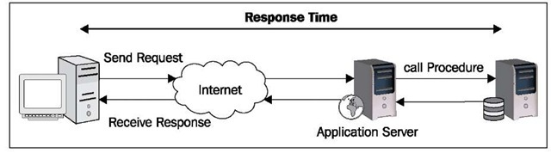
Response Time

Slide 8
Response Time
At this point the concept of Response Time should be quite clear, but you might wonder if this measurement is a constant; actually it is not.
The Response Time changes accordingly with the load on the application.
A single operation cannot be indicative of the overall performance: you have to consider how long the procedure takes to be executed in a production environment, where you have a considerable amount of customers running.

Slide 9
Throughput
Throughput is the number of transactions that can occur in a given amount of time. This is a fundamental parameter that is used to evaluate not only the performance of a website, but also the commercial value of a software.
The Throughput is usually measured in Transactions Per Second (TPS) and obviously an application that has a TPS higher than its competitors is also the one with higher commercial value — all other features standing equal.

Slide 10
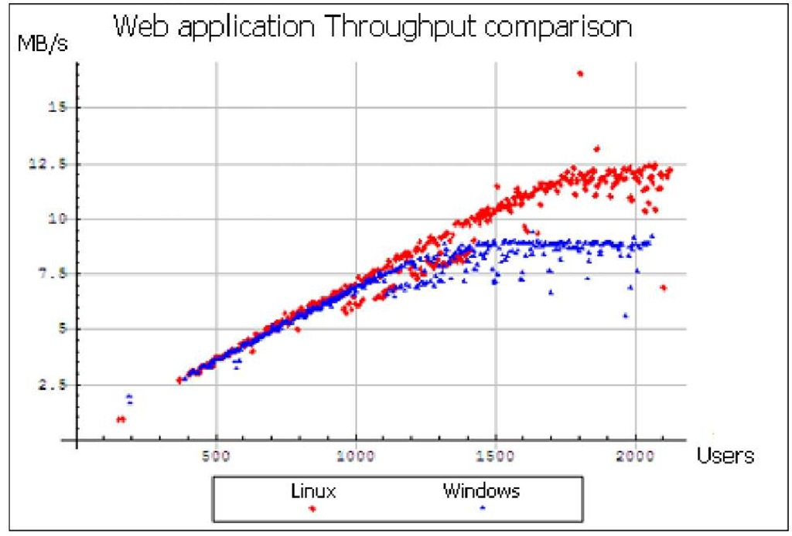
Throughput
This image, depicts a Throughput comparison between a Linux Server and a Windows Server, as part of a complete benchmark (http://www.webperformanceinc.com/library/reports/windows_vs_linux_part1/index.html):

Slide 11
Scalability: the other side of performance
As we have just learnt, we cannot define performance within the context of a single user who is testing the application.
The performance of an application is tightly coupled with the number of users, so we need to define another variable which is known as Scalability.
Scalability refers to the capability of a system to increase total Throughput under an increased load when resources are added. It can be seen from two different perspectives:
• Vertical scalability: (otherwise known as scaling up) means to add more hardware resources to the same machine, generally by adding more processors and memory.
• Horizontal scalability: (otherwise known as scaling out) means to add more machines into the mix, generally cheap commodity hardware.

Slide 12
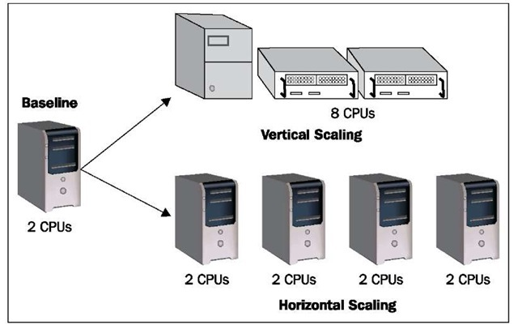
Scalability

Slide 13
Scalability
Both solutions have pros and cons: generally vertical scaling requires a greater hardware expenditure because it needs upgrading to powerful enterprise servers, but it’s easier to implement as it requires fewer changes in your configuration.
Horizontal scaling on the other hand, requires little investment on cheaper hardware (which has a linear expenditure) but it introduces a more complex programming model, thus it needs an expert hand as it concerns configuration and might require some changes in your application too.
You should also consider that concentrating all your resources on a single machine introduces a single point of failure, which is the case if you choose an extreme type of vertical scaling.

Slide 14
Tuning
Performance tuning becomes essential when the system indicates sluggish or becomes absolutely unresponsive.
Usually, this happens due to increased load with some degree of decreasing performance.
Thus, Corporations can save a lot of money using Performance tuning just by modifying a system to handle higher loads and thereby enhance the server performance without spending on new infrastructure or applications.

Slide 15
Tuning
Application Tuning: Analysis of the code and suggesting better coding practices, which will resolve 80% issues.
Database Parameter Tuning: Optimal sizing of DB buffer, shared a pool, buffer cache, etc, changing the SGA / PGA parameters.
Database contention: Elimination/minimization of deadlocks, blocking session, wait for events, data partitioning.
Operating system: Monitor and tune CPU, I/O, memory utilization.
Caching: Improvement of performance by retaining the frequently accessed data in the cache, ensuring proper utilization of resources and avoiding repeated computation.

Slide 16
Tuning
you cannot think of performance as a single step in the software development process; it needs to be a part of your overall software development plan.
Achieving maximum performance from your software requires continued effort throughout all phases of development, not just coding.

Slide 17
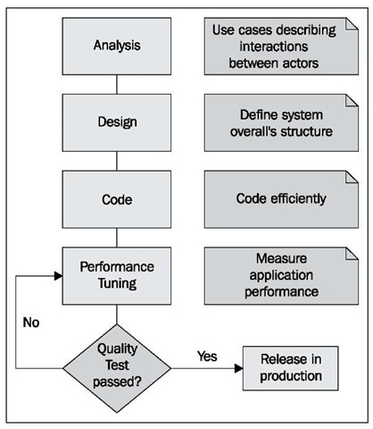
Tuning in the software development cycle
As you can see, the software process contains a set of activities (Analysis, Design, Coding, and Performance Tuning) which should be familiar to analyst programmers, but with two important additions:
First there is a new phase called Performance Test which begins at the end of the software development cycle and will measure and evaluate the complete application.
Secondly, every software phase contains Performance focal points, which are appropriate for that software segment.

Slide 18
Analysis
Producing high quality, fast applications always starts with a correct analysis of your software requirements. In this phase you have to define what the software is expected to do by providing a set of scenarios that illustrate your functional domain.
This translates in creating use cases, which are diagrams that describe the interactions of users within the system.
These use cases are a crucial step in determining what type of benchmarks are needed by your system: for example, here we assume that your application will be accessed by 500 concurrent users, each of whom will start a database connection to retrieve data from a database.
Software analysis, however, spans beyond the software requirements and should consider critical information, such as the kind of hardware where the application will run or the network interfaces that will support its communication.

Slide 19
Design
In this phase, the overall software structure and its nuances are defined. Critical points like the number of tiers needed for the package architecture, the database design, and the data structure design are all defined in this phase.
A software development model is thus created. The role of performance in this phase is fundamental, architects should perform the following:
Quickly evaluate different algorithms, data structures, and libraries to see which are most efficient.
Design the application so that it is possible to accommodate any changes if there are new requirements that could impact performance.

Slide 20
Code
The design must be now translated into a machine-readable form. The code generation step performs this task.
If the design is performed in a detailed manner, code generation can be accomplished without much complication.
If you have completed the previous phases with an eye on tuning you should partially know which functions are critical for the system, and code them in the most efficient way.
We say "partially" because only when you have dropped the last line of code will you be able to test the complete application and see where it runs quickly and where it needs to be improved.

Slide 21
Performance Test
This step completes the software production cycle and should be performed before releasing the application into production.
Even if you have been meticulous at performing the previous steps, it is absolutely normal that your application doesn’t meet all the performance requirements on the first try.
In fact, you cannot predict every aspect of performance, so it is necessary to complete your software production with a performance test.
A performance test is an iterative process that you use to identify and eliminate bottlenecks until your application meets its performance objectives. You start by establishing a baseline. Then you collect data, analyze the results, and make configuration changes based on the analysis. After each set of changes, you retest and measure to verify that your application has moved closer to its performance objectives.

Slide 22
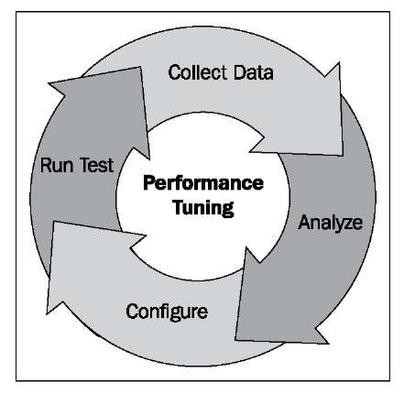
The following image synthesizes the cyclic process of performance tuning:

Slide 23
Difference between Performance & Tuning processes & other Infrastructure processes
Performance and tuning processes are focused on optimizing the performance and efficiency of an existing system. | Infrastructure processes are focused on maintaining and improving the underlying infrastructure that supports the system. They are essential for ensuring that the system can operate reliably and securely over the long term.
Performance and tuning processes typically involve activities such as analyzing system performance metrics, identifying bottlenecks, and making adjustments to improve system response times, throughput, and scalability. | Infrastructure processes are concerned with managing the hardware, software, and networking components that support the system.
These processes are often iterative, with adjustments made over time as the system is used and performance issues are identified. | These processes include activities such as server maintenance, security management, software updates, and disaster recovery planning. Infrastructure processes are essential for ensuring the reliability, availability, and security of the system.

Slide 24
Monitoring SQL Server Components: A 5-Step process
SQL Server runs a dynamic environment: application data changes and the number of users or applications and the way they interact with the database can also change.
A SQL Server database automatically manages system resources, like disk space and memory, to reduce the need for large-scale manual optimization. SQL Server performance tuning allows administrators to view performance trends and determine if changes are needed.

Slide 25
1. Determine monitoring goals
In order to effectively perform SQL Server performance tuning, clarify the reasons you are monitoring the system. Your monitoring goals can include:
Defining a performance benchmark and identifying changes in performance over time
Diagnosing specific performance problems and identifying the component or process to be optimized
Comparing the performance impact of different applications, monitor user activity, or test how the database reacts to different levels of load
Testing scheduled maintenance, backup and recovery plans
Testing different variations of database architecture or hardware setup

Slide 26
2. Choose a Tool
Now that you have determined the reasons for monitoring, you can choose the right tool for monitoring.
SQL Server offers performance tuning capabilities, as does the Windows operating system itself, allowing you to monitor environments with heavy transactional loads

Slide 27
3. Select components and metrics
Determine which components of the SQL Server database you need to monitor. SQL Server Profiler lets you perform traces to monitor specific types of events, or exclude irrelevant events. Select events that are relevant for the components you need to track
After determining the components to be tracked, determine the metrics to be tracked. Once you have selected events for monitoring, you can specify that only certain event data will be included, to ensure the data is relevant to your monitoring goals. Limiting the data you collect in a trace also conserves system resources required for SQL Server performance tuning

Slide 28
4. Monitor the database
Start running your monitoring tool on an ongoing basis and collect data about selected events and metrics

Slide 29
5. Analyze the Data
Analyze the data collected by the tool to ensure that the monitoring objectives are achieved. If you cannot achieve your goals based on the data – for example, you cannot identify the source of the performance problem – modify the components or metrics you are tracking

